Slide 1
SmartPeerJS: A library for turning smartphone in interactive controller
Emma Poliakova

Slide 2
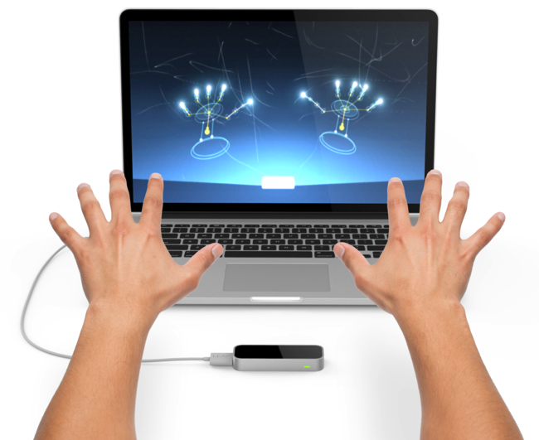
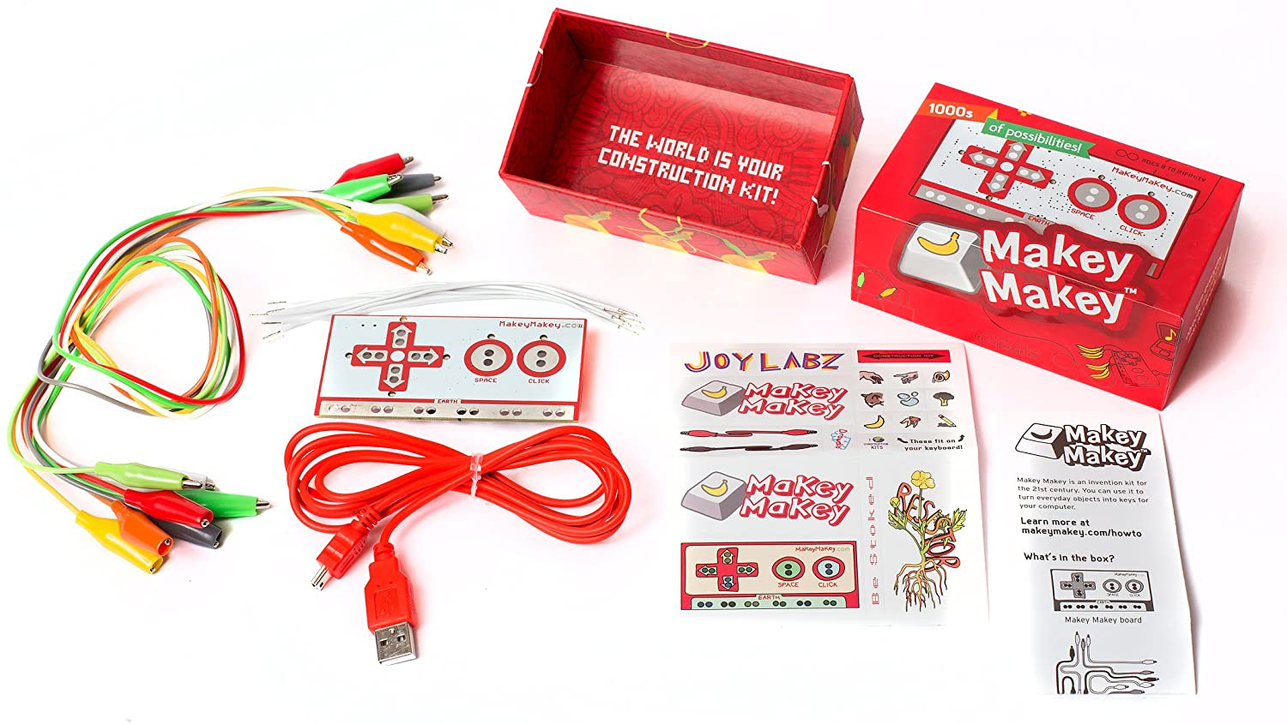
Motivation
Almost everyone owns a smartphone with good processing power and an array of sensors
Touchscreen for various game controllers – joystick, NES/Playstation style controller, camera for hand tracking or object recognition, accelerometer for racing games
Smartphone controllers are free and require no software installation
Leap motion controller
Makey makey invention kit
Makey-makey: https://m.media-amazon.com/images/I/81Or74Q0RYL._AC_SL1500_.jpg
Leap motion: https://cdn-blog.adafruit.com/uploads/2014/09/NewImage90.png

Slide 3
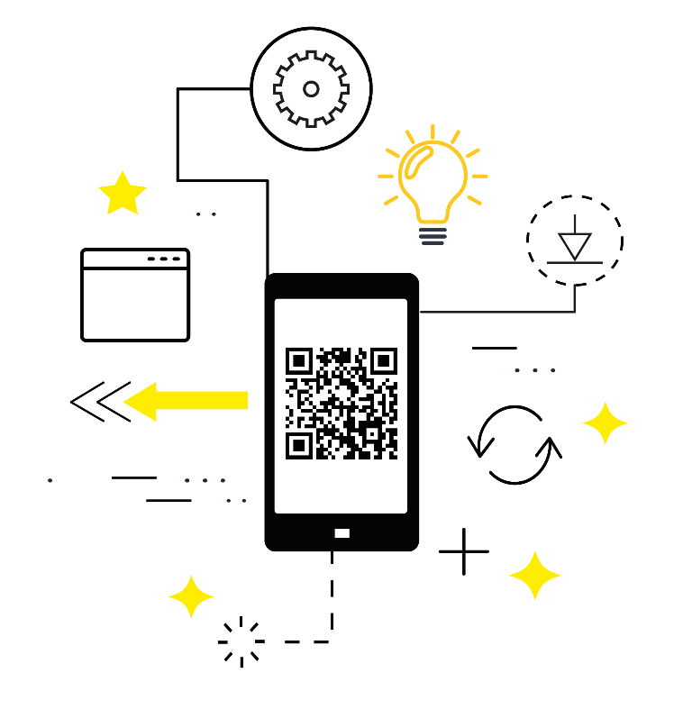
Goals
Automatic connection handling
Supporting multiplayer
Hosting pre-made controllers
Easy way of creating new controllers
Creating a GitHub organization for the library
Making user documentation, tutorials and demos
Publishing the library on npm
SmartController organization logo

Slide 4
Design
Survey to name the library, suggestions included web smartphone controller, game controller, rtc smart controller, JS P2P smartphone game
Use WebRTC and PeerJS to connect smartphone via QR code
SmartController manages the connection in the computer browser , SmartPhoneController is responsible for the smartphone side
Simplified SmartController structure

Slide 5
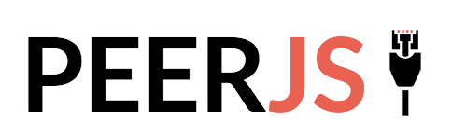
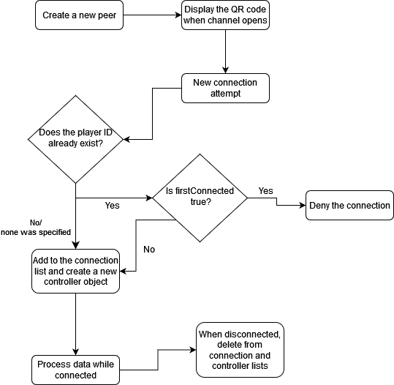

Implementation
Use of PeerJS
Qr code method
Events with EventEmitter2
Statistics – ping, user message rate, statistics message rate
SmartPhoneController send method and message throttle
Basic SmartController flowchart

Slide 6
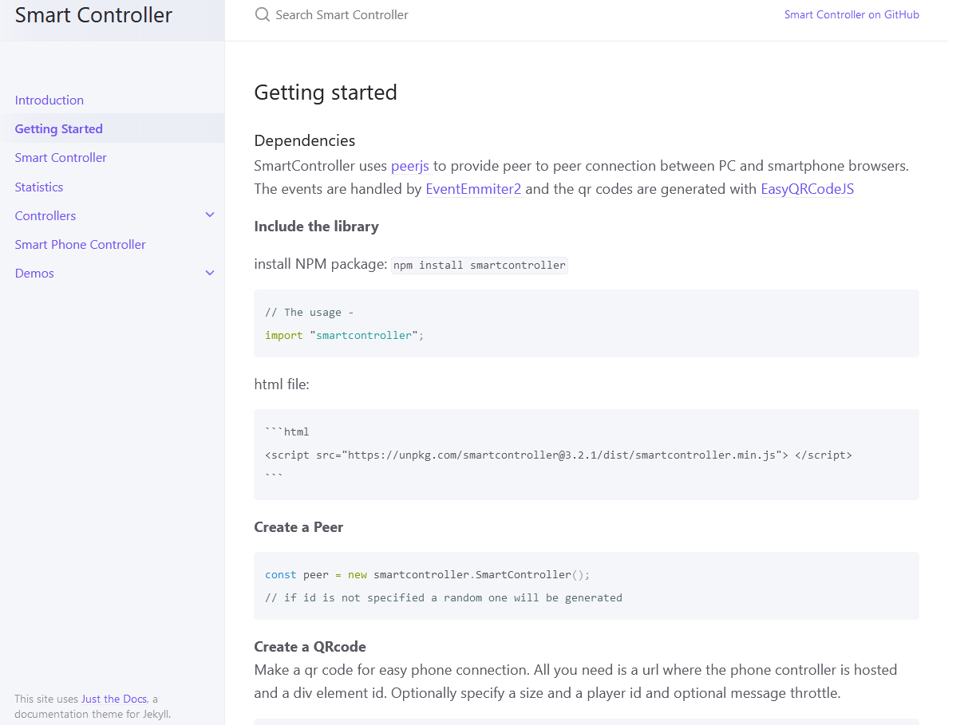
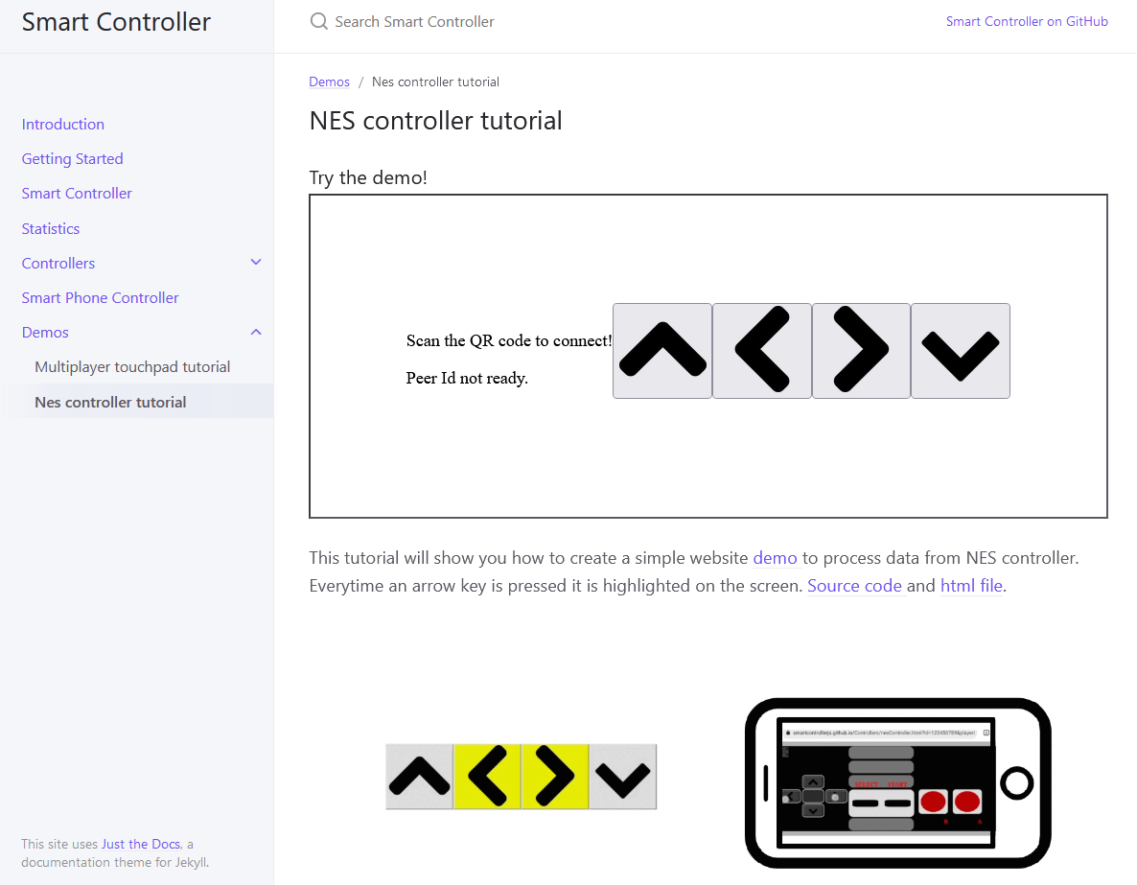
Working with users
While developing the library I worked with two fellow students who used it to create their own projects
There were weekly meetings where we discussed and issues or problems they had, or any functionalities that they needed but the library did no offer yet
At the end I conducted a short interview to find out their overall experience of working with the library

Slide 7
Demos
Showcase the library functionalities
Tutorials for new users

Slide 8
Thank you for your attention!

